Slide 1
Virtualization

Slide 2
Virtual Machines

Slide 3


Why we need Virtual Machine?

Slide 4


Why we need Virtual Machine?
RAM, CPU, SDD
Hardware

Slide 5
Why we need Virtual Machine?
Windows OS
RAM, CPU, SDD
Hardware

Slide 6
Why we need Virtual Machine?
Applications
Windows OS
RAM, CPU, SDD
Hardware

Slide 7

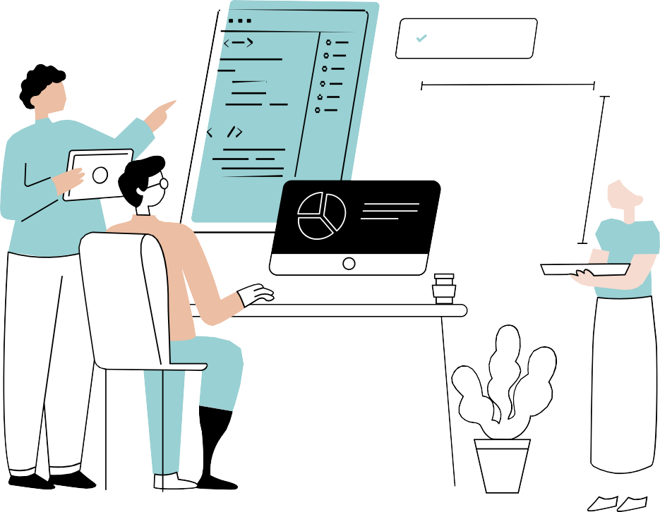

software

Slide 8





Why we need Virtual Machine?

Slide 9


Buy a new machine to run Linux?

Slide 10

No worries We have Virtualization

Slide 11

Windows
Hardware

Slide 12
Virtualization
Windows
Windows
Hardware

Slide 13





Linux OS
Virtualization
Windows
Windows
Hardware

Slide 14
















Windows
Windows
Linux OS
Virtualization
Virtualization
Virtualization
Linux
Mac OS
Windows
Hardware
Hardware
Hardware

Slide 15
But How to setup the Virtualization?

Slide 16
Hypervisor

Slide 17
Hypervisor
It is software that creates and runs virtual machines (VMs).

Slide 18











Hypervisor
HOST OS

Slide 19
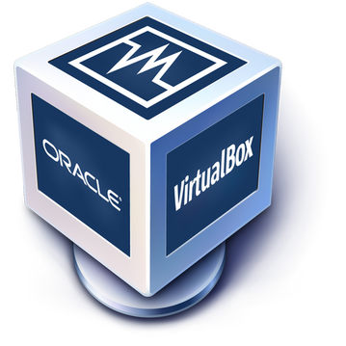








Hypervisor
HOST OS

Slide 20

How Hypervisor works?
Virtual box share hardware resources from Host OS
Separate set of virtual CPU, RAM, storage etc
VMs are fully isolated (independent of hosted OS)
Hypervisor

Slide 21
























VM1
2GB RAM
20 GB HDD
2GB RAM
10 GB HDD
VM2
8GB RAM
100GB HDD

Slide 22












Benefits of VMs
We don't need new resources to use different OS No risk of any issues with your primary OS
Testing any app on different OS

Slide 23
Types of Hypervisor
Type1(Bare Metal)
Type2 (hosted)

Slide 24
Hypervisor
HOST OS
Type 2 (Hosted)

Slide 25



















Type 1 (Bare-Matel)
Hypervisor
VMware vSphere / ESXi
Xen / Citrix XenServer
Hardware

Slide 26
Type 1 (Bare-Matel)
Used by Cloud Providers and Enterprise Servers.

Slide 27

Why do companies use virtualization?

Slide 28




Virtualization Use Case
Cheap Reduces
workload Space Energy
Easy backup using snapshot Easy recovery

Slide 29
Thank
you!

Slide 30
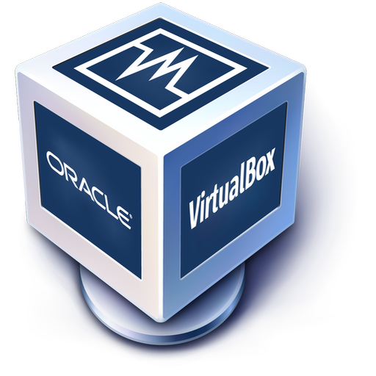
Linux VirtualBox Setup On Windows
Linux CentOs

